Slide 1
Spray-Tek’s Data Visualization Development
MGT-809A
Zi Wang Pranay Bhandare
Jungho Park Yi Yi
Hao Yan
Under the guidance of Prof. Alkiviadis Vazacopoulos
Notes:
Change title
-development of warehouse/BI solutions
- analyze data, insights, develop visualizations
- take out forecasting (future works)

Slide 2
Overview
Our team’s objective is to perform analysis on Spray-Tek, inc.’s spray drying production and weather data to deliver insights/solutions for production through exploration of data to meet the needs of Spray-Tek, Inc.
Conducted weekly meetings with IT Managers, Brett Koelle and Brett Robertshaw, to discuss problems and insights discovered during the project and understand the business context of the analysis the team was conducting
Visited their plant in order to get more clarity on Spray-tek’s products/services regarding spray drying production
Notes:
Hao

Slide 3

Spray-Tek, Inc.
Provides quality spray drying solutions in order for its customers to lower net product costs, increase yields, and guarantee consistent quality of products with their dryer equipment
2 essential facility locations
Middlesex, NJ
Bethlehem, PA
Because the spray drying process uses air in their production processes the sponsor company was curious whether weather features have a significant effect on the production performance
Providing business intelligence solutions based on weather data, downtime, and preventive maintenance issues are the goals for the project.
Notes:
Hao

Slide 4

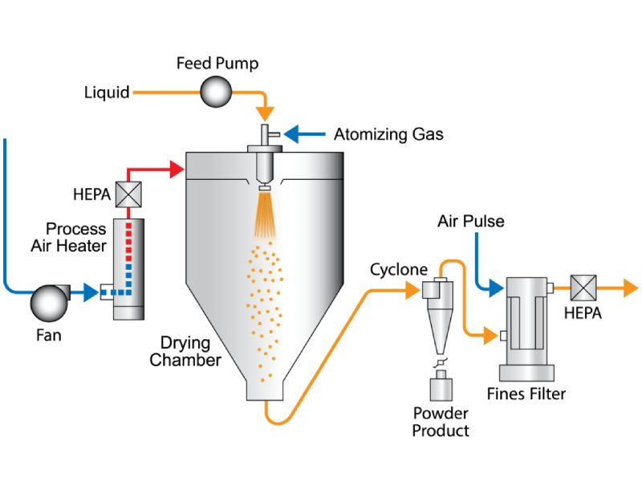
The Problem
Our team developed the following questions to be answered for the project:
● Will weather impact the machine efficiency in different times?
● How is the impact difference between different dryers?
● What is the most important weather factor? Humidity?
● Does weather impact differently among production products? (e.g. Food additives, flavors, chemicals, etc.)
Notes:
Hao

Slide 5
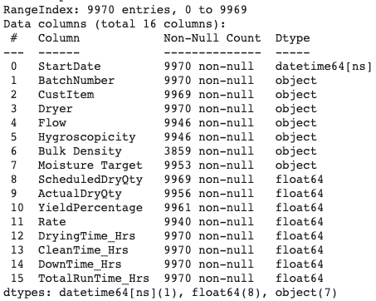
Data Understanding (Production)
Column | Desc. | Data
StartDate | DateTime for prod. start | 1/1/16~12/30/20
BatchNumber | Assigned Batch # | NJSD313***
Dryer | Assigned Dryer | Dryer 1 ~ 11
ScheduledDryQty | Intended outcome | 333.7357
ActualDryQty | Actual outcome | 352.2
Rate | Actual / Scheduled * 100 | 146.75
YieldPercentage | ActualDryQty / DryingTime_Hrs (N) | 105.5
DryingTime_Hrs | spray dry processing time | 2.4
ProdLine | Production categories | Food Additive, Fragrances, etc.
16 ProdLine
Notes:
Hao

Slide 6
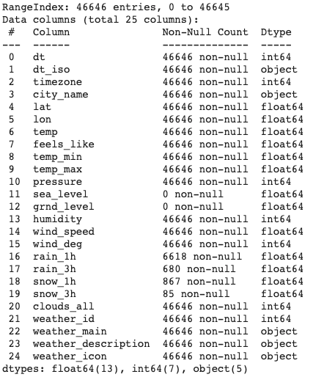
Data Understanding (Weather)
•Time obj: dt, dt_iso, timezone
•Location obj: city_name, lat, lon
•Numerical weather data: Temp, feels_like, temp_min, temp_max, pressure, humidity, wind_speed, wind_deg, rain, snow
•Categorical weather data: clouds_all, weather_id, weather_name, weather_description, weather_icon
Notes:
Hao

Slide 7
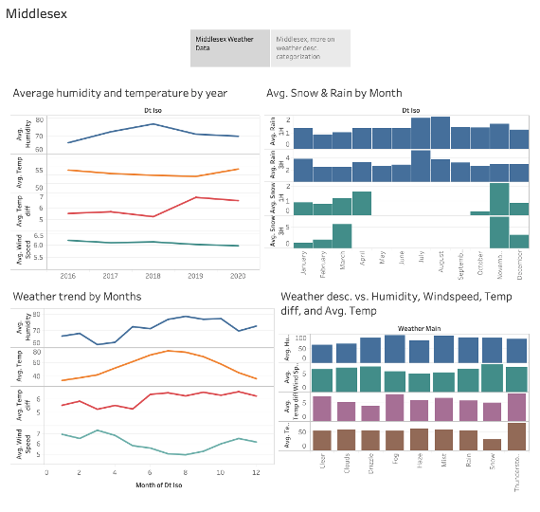
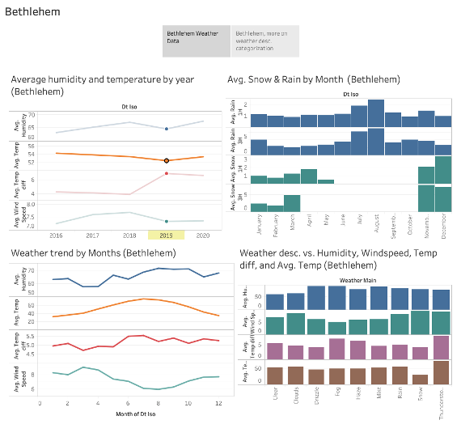
Data Understanding (Weather)
Notes:
Hao

Slide 8
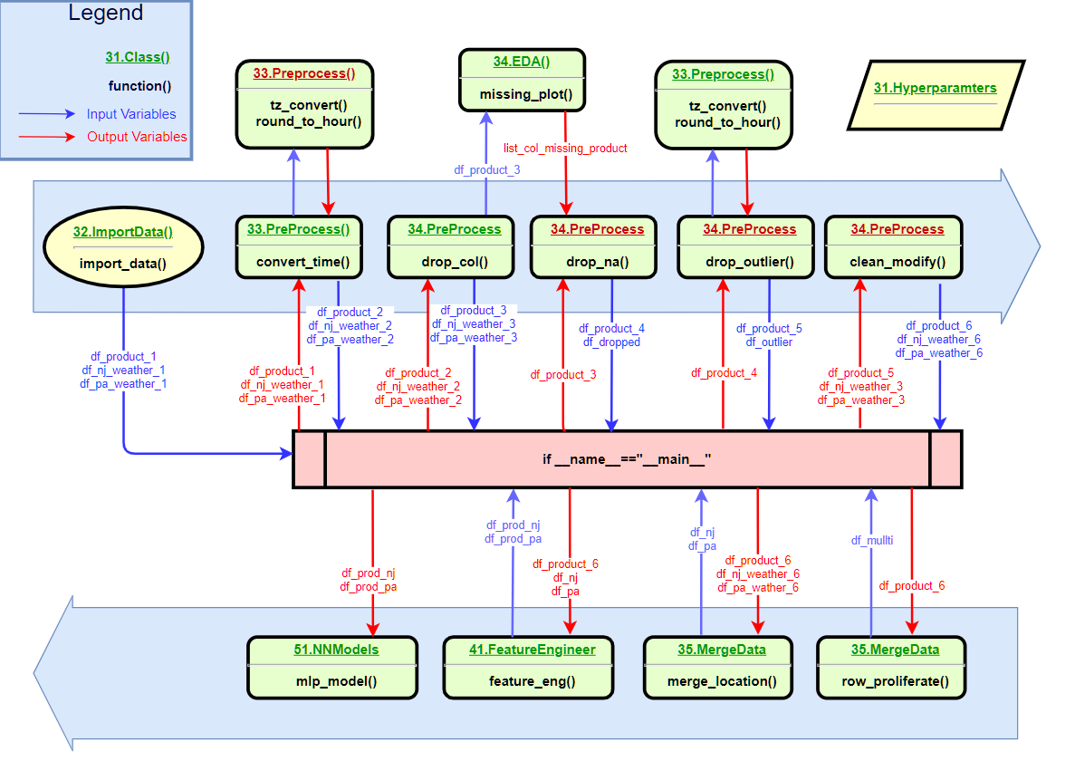
Data Preprocessing
Conducted basic data preprocessing techniques to proceed with data warehousing and descriptive analytics
Software flow diagram to visualize python scripts
Notes:
Jungho
To answer those questions mentioned in the problem section, the initial step is to understand the data. Exploratory data analysis on production and weather data and communication with Spray-Tek, inc. provided us data description, points to merge two data, and guidelines to clean the data. Our team implemented python to import, preprocess, clean, and merge data into one tabular form (dataframe). As a result, the data consists of production data with corresponding weather data.
Some of the preprocessing tasks were outliers & missing values, datetime conversions, merge, feature engineering

Slide 9
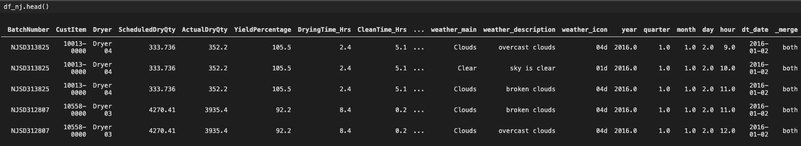
Data Preprocessing (cont.)
Post Merge
Tabular production data merged with relevant weather information
New production features
Merge on time features
Notes:
Jungho
This tabular data shows both production & weather data after merging on corresponding time.
As shown in the data format, production data is attached with relevant weather information, adding those columns to the left of the production data.

Slide 10
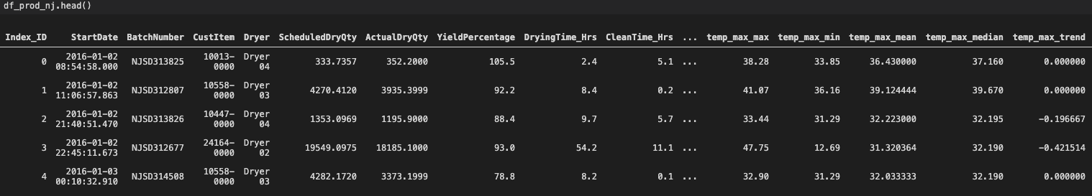
Data Preprocessing (cont.)
Post Feature Engineering
Added descriptive statistics features
Notes:
Jungho
Our feature engineering mainly focuses on population descriptive weather statistics features to each production data.
We have implemented python to add descriptive statistics such as max, min, mean, median of temperature, humidity, wind speed, etc.

Slide 11
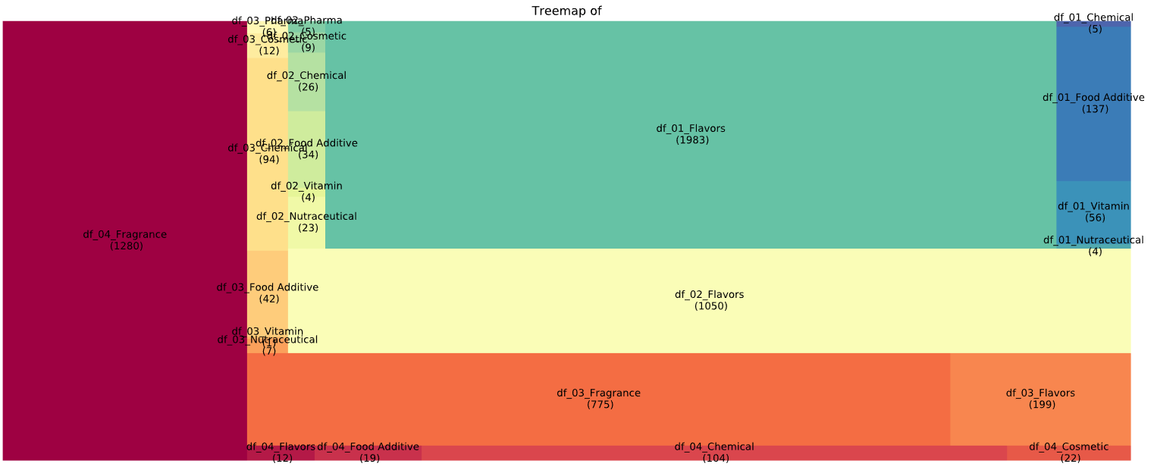
TreeMap (Dryer & Prodline) - NJ
Notes:
Jungho
After preprocessing, we examined how many product lines were assigned to Spray Tek’s 11 different dryers.
The visualization of those assignments are presented as 2 Tree Maps from NJ and PA locations
In the NJ treemap, the following insights are:
Dryer 1

Slide 12
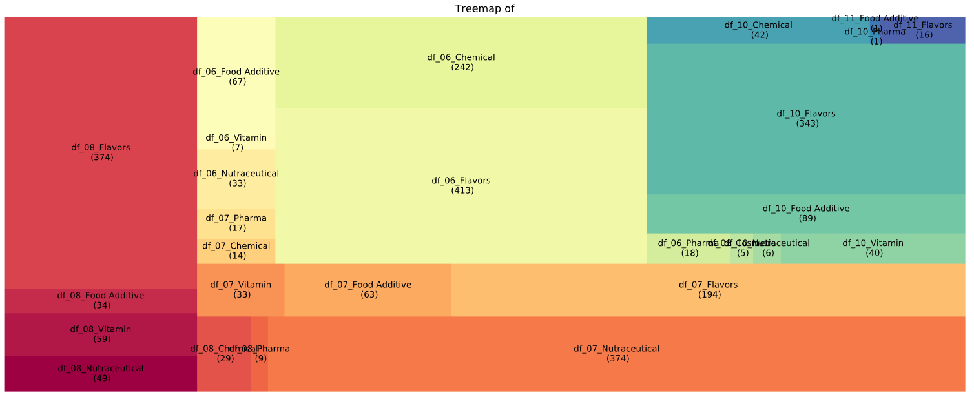
TreeMap (Dryer & Prodline) - PA
Notes:
Jungho

Slide 13
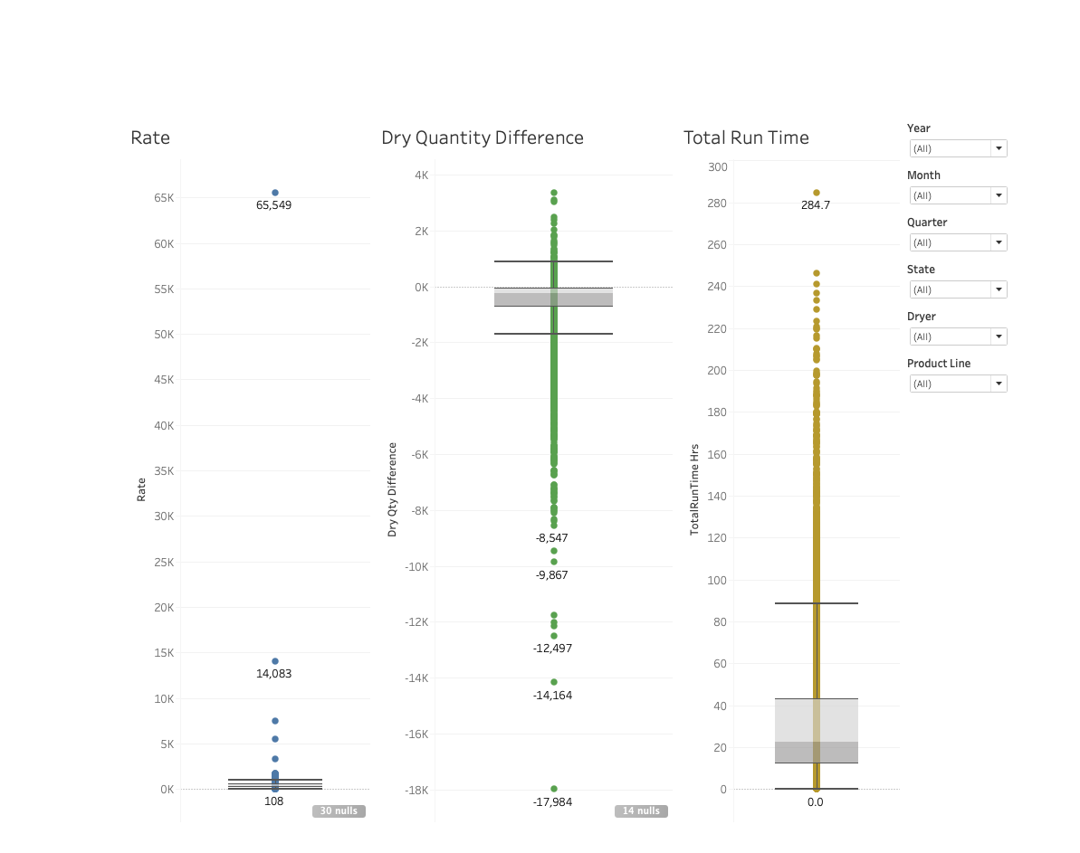
Project Deliverables
After these two initial phases of understanding the data, our team was able to create comprehensive visualizations about weather and production with adjustable filters to analyze characteristics of various past productions using Tableau and Python.
As per Spray-Tek, Inc’s request, our team provided dashboards to analyze a variety of problems regarding production data and attempted to further find relationships between the two datasets
3 main dashboard functions:
Outlier/Anomaly Detection
Product Line Runs vs. Weather Features
Correlation analysis on production performance indicators
Notes:
Jungho
Weather features: humidity, temperature, rain, windspeed
Prod Performance Indicators: rate & yield & dry time
The dashboard on the right displays outliers on PPI’s - rate, dry qty diff, total run time

Slide 14
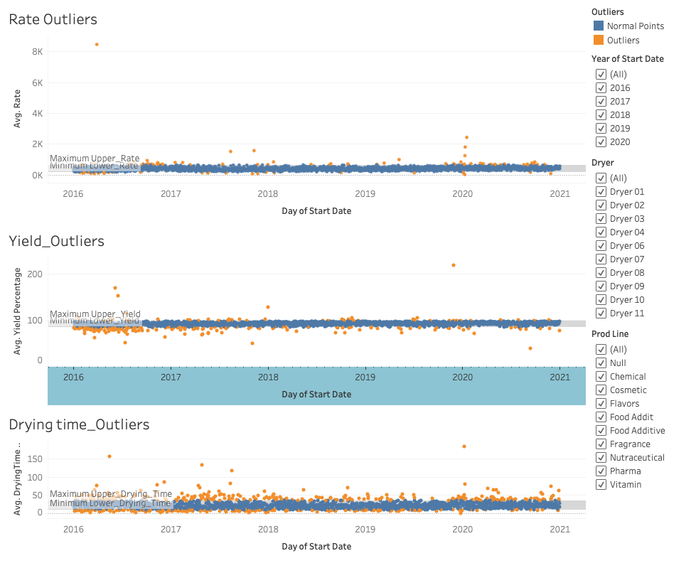
Outlier Detection
Helps to detect outliers within production performance indicators
Ability to dive deeper into granular levels of the data
Consists of 6 years of data
Notes:
Pranay
This dashboard is to detect outliers based on 3 Prod. performance indicators - rate, yield, drying time - which Spray Tek provided to us they wanted to detect outliers for
The blue points are normal points and the orange points are outliers as indicated through IQR statistics
All dashboards are customizable to further break the data down by features such as date, state(facility), product line and dryer

Slide 15
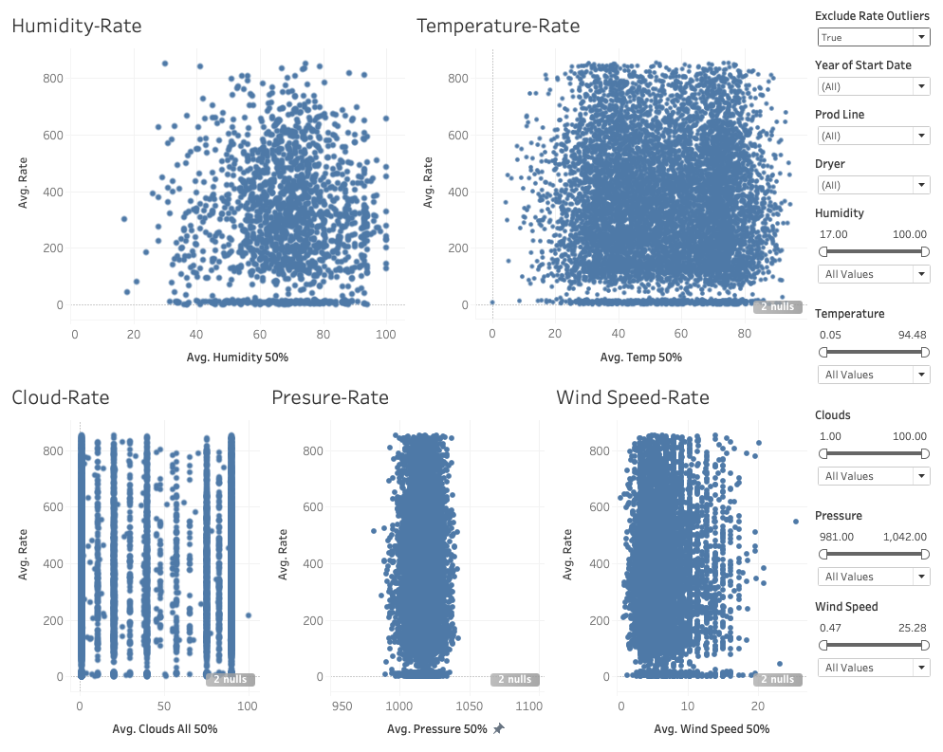
Rate ~ Weather Features
Rate versus weather features
Spray-Tek was curious of seeing the effect of weather features on rate
Ability to filter out outliers and anomalies to visualize distributions of meaningful data
Notes:
Pranay
This dashboard was created to understand the relationship between rate & various weather features.
Spray Tek was curious of seeing the effect of weather features on rate, a key indicator of production performance
This dashboard is very impactful because it has the ability to filter out outliers/anomalies and be able to visualize the distributions of meaningful data

Slide 16
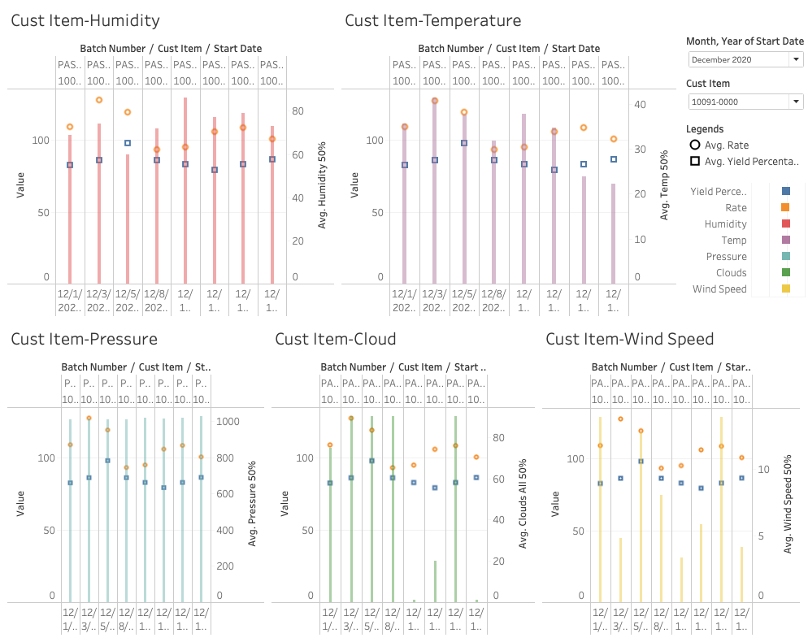
Product Line ~ Weather Features
Help identify weather effects on rate and yield percentage
Spray Tek was curious if weather features had any effect on specific product lines
Notes:
Pranay
Product Line Analysis - try to discover any meaningful relationships between product line and weather features

Slide 17
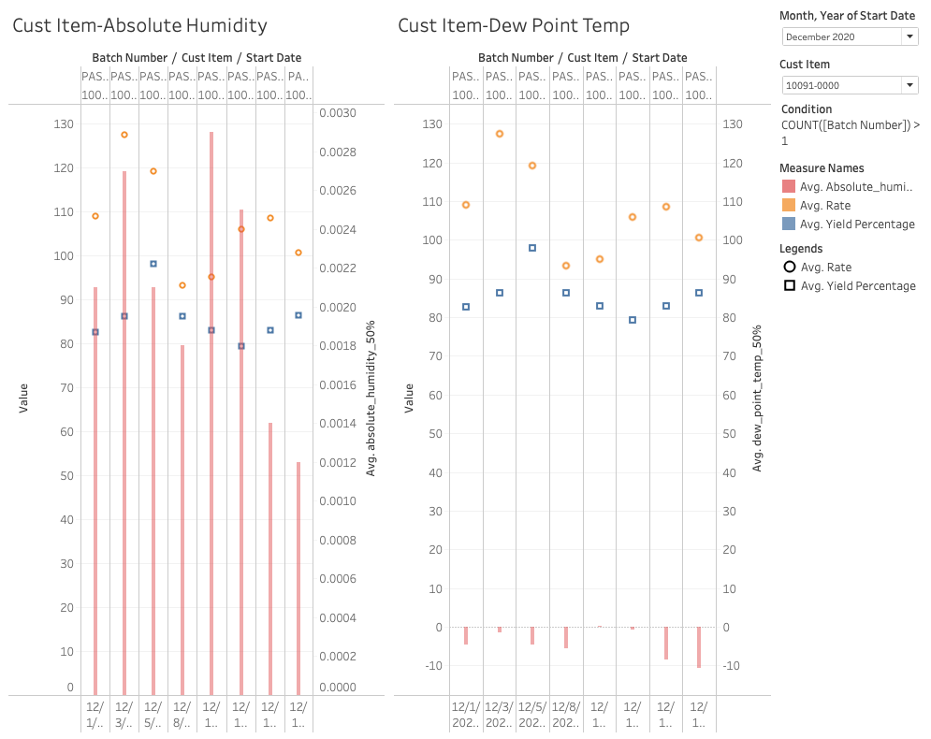
Product Line ~ Weather Features
Compare absolute humidity and dew point temperature amongst product lines
Absolute humidity and dew point temp are better indicator of actual atmospheric moisture
Dew point formula
Td = T - ((100 - RH)/5.)
Notes:
Pranay

Slide 18
Conclusion & Future Works
One of the main goals of this project is to deliver information about potential impacts of weather on Spray Tek’s spray drying processes
The absence of a significant relationship between weather and production performance indicators allowed us to pivot into business intelligence solutions
Increase data warehousing capabilities to address multiple business problems/questions
Provided future guideline for the team and customer to focus and discover on other relative features for production KPI predictive analysis
Deliver any data visualization analyses based on Spray-Tek’s business problem identifications
THANK YOU!
ANY QUESTIONS?
Notes:
Pranay

